Slide 1
natural numbers, Primes and Multi-Layered Perceptrons
Nathan hall
Rohan Saha

Slide 2
Objective
Take a preliminary step into seeing if using an ensemble of primality/composite tests can lead to a “good” prediction of prime numbers.

Slide 3
Background
Ensemble algorithms tend to outperform single, well crafted, algorithms.
Geometric representations of Natural numbers can influence/dictate the algebraic description of subsets of Natural numbers.

Slide 4
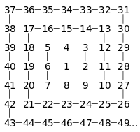
Ulam Spiral

Slide 5
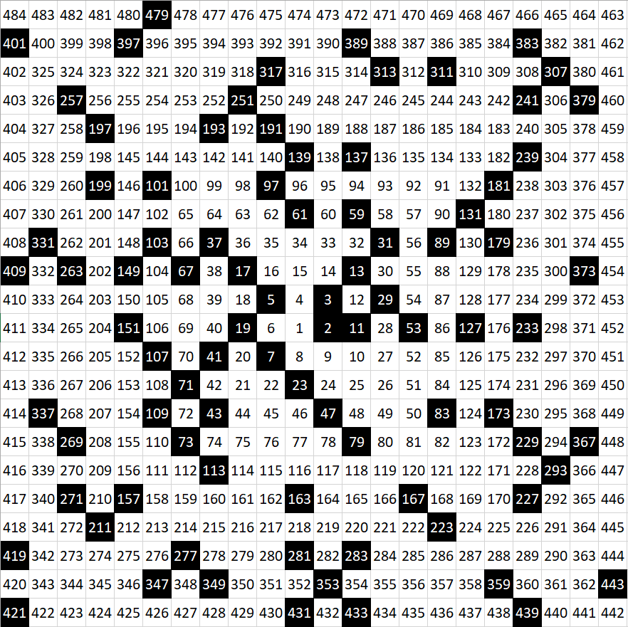
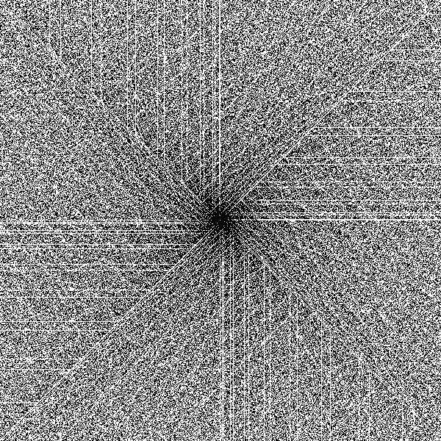
Ulam Primes

Slide 6
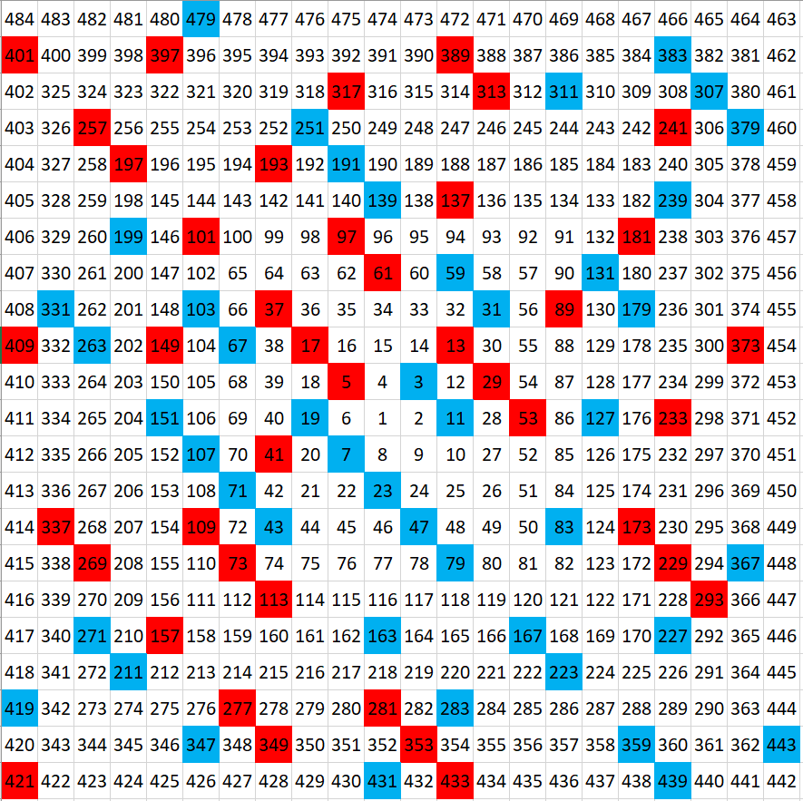
Ulam Gaussian Primes & Composites

Slide 7
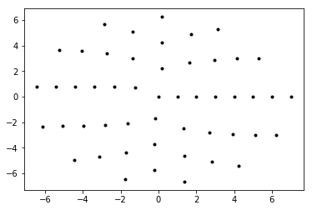
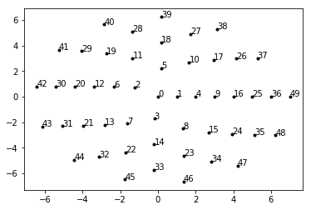
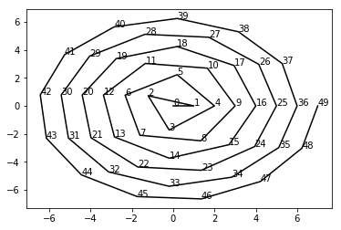
Sack’s Spiral

Slide 8
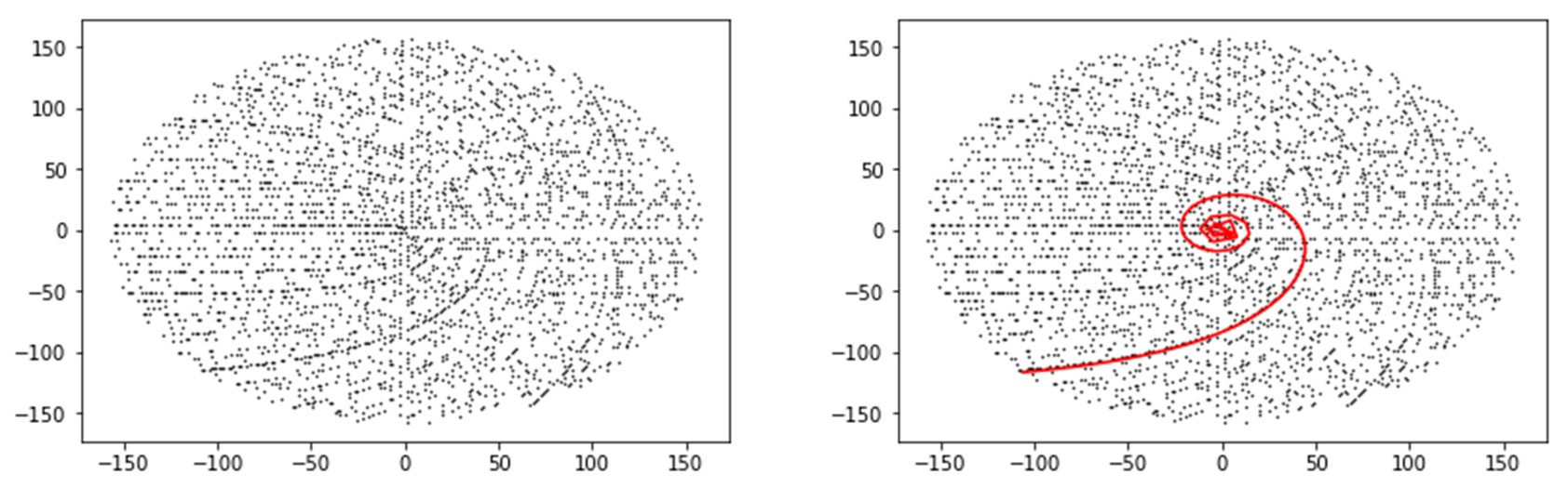
Sack’s Primes

Slide 9
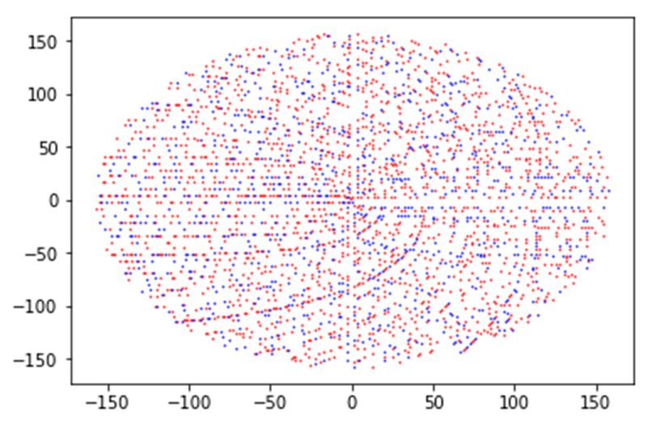
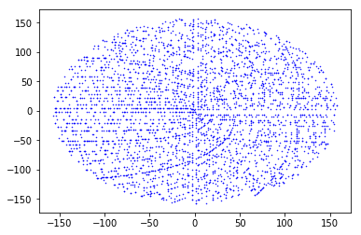
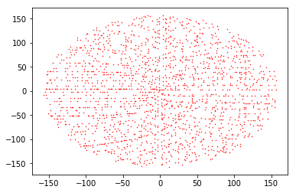

Slide 10
Big Picture
Attempt to predict the classification of a number, without knowing the number itself, but by strictly looking at its attributes.
The attributes are the ensemble of results to several primality/composite tests.

Slide 11
Common Tests to Find Characteristics of Natural Numbers
Fibonacci Numbers - Selfridge’s Conjecture Lucas Numbers - Baillie-PSW Exponentiation - Fermat’s Little Theorem (FLT), Selfridge, Baillie-PSW Mod 4 - Gaussian Factorization Mod 5 - Selfridge Mod 6 - General Arithmetic Property Mod p - Wilson, Baillie-PSW, FLT

Slide 12

General Arithmetic Properties
All primes, > 3, are of the form 6n $±$ 1, where n is a Natural number.
Ex. Let n = 1. Then:
6n – 1 = 5
6n + 1 = 7

Slide 13

Wilson’s Theorem
(p – 1)! $≡$ -1 mod p
Ex. Let p = 5. Then:
(5 – 1)! (mod 5)
= 4! (mod 5)
= 4 * 3 * 2 (mod 5)
= 24 (mod 5)
$≡$ 4 (mod 5)
$≡$ -1 (mod 5)

Slide 14

Selfridge Conjecture
Given p = 2k + 1 and p $≡$ $±$ 2 (mod 5), if $2^{p−1}$ $≡$ 1 (mod p) and $f_{p+1}$ $≡$ 0 (mod p), then p is prime. *$f_{n}$ is the nth Fibonacci number.
Ex. Let p = 7, then: $2^{7−1}=2^{6}=64≡1$ (mod 7) and $f_{7+1}=f_{8}=21≡0$ (mod 7). Hence, 7 is prime
This is still an open problem

Slide 15
Baillie-PSW (Pomerance, Sulfridge, Wagstaff)
Same as Selfridge’s Conjecture, but substitute Lucas numbers for Fibonacci numbers.

Slide 16

Fermat’s Little Theorem
$$a^{n−1}≡1 (mod n)$$
Using a = 2, this is already included in the Sulfridge/Baillie-PSW.

Slide 17
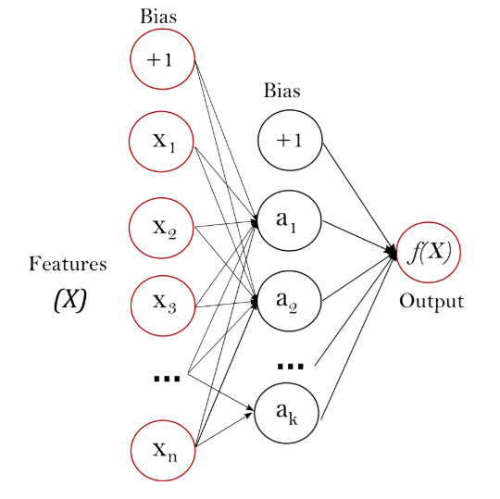

Multilayer Perceptron

Slide 18
Why MLP?
A perceptron can be used to separate any two sets of linearly separable numbers
A single perceptron can represent Boolean functions such as AND, OR, NAND and NOR
The perceptron outputs 1 for instances lying on one side of the hyperplane and output 0 for instances lying on the other side.

Slide 19
Multilayer Perceptron (Scikit Learn)
MLPClassifier implements a multi-layer perceptron (MLP) algorithm that trains using Backpropagation
hidden_layer_sizes : Represents the number of neurons in the hidden layer
activation : Activation function for the hidden layer
Identity : Implement linear bottleneck, returns f(x) = x
Logistic : Sigmoid function, returns f(x) = 1 / (1 + exp(-x))
Tanh : Hyperbolic tan function, returns f(x) = tanh(x)
Relu : Rectified linear unit function, returns f(x) = max(0, x)
solver : Weight optimization
Sgd: refers to stochastic gradient descent
max_iter : 100
Verbose: Whether to print progress messages to stdout

Slide 20
Dataset Validation
train_test_split: Split arrays or matrices into random train and test subsets
Input :
X : List of attributes
Y : List of class label
test_size : Represent the proportion of the dataset to include in the test split
random_state : The seed used by the random number generator
Output : List containing train-test split of inputs

Slide 21
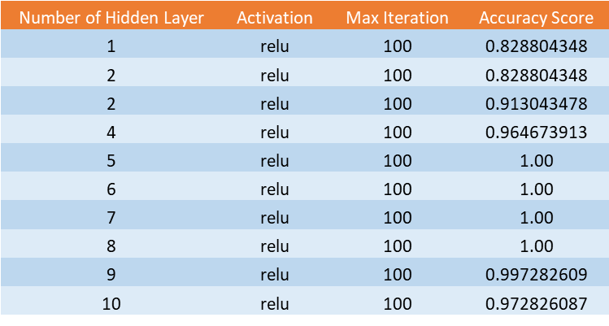
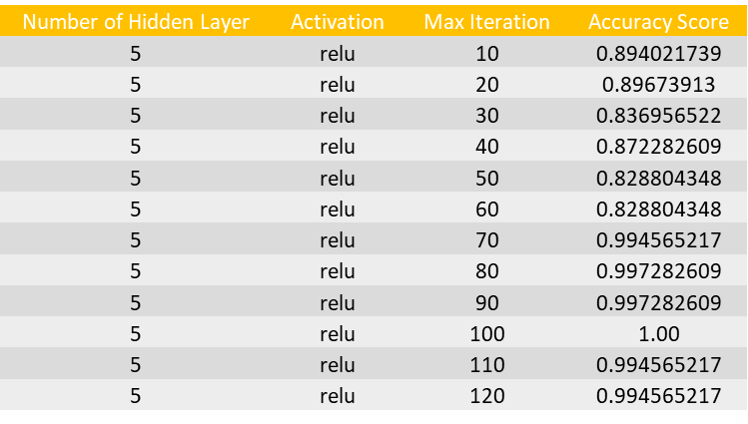
Experiment and Results
Number of Hidden Layer | Activation | Max Iteration | Accuracy Score
5 | relu | 100 | 1.00
5 | tanh | 100 | 0.991847826
5 | logistic | 100 | 0.828804348
5 | identity | 100 | 0.997282609

Slide 22
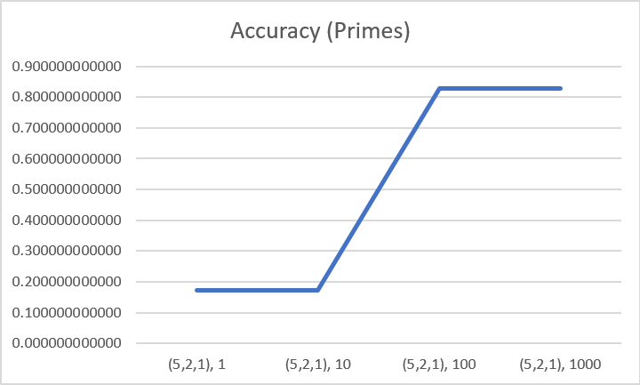
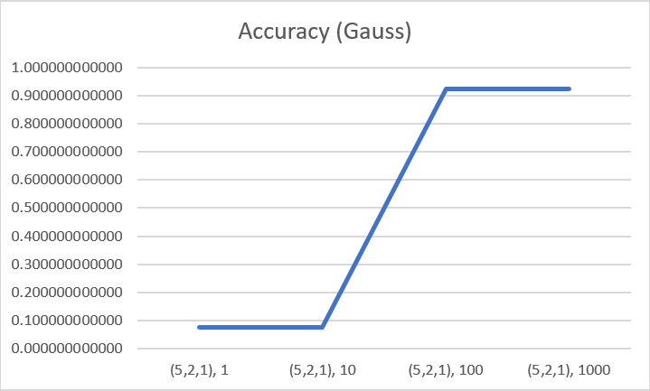
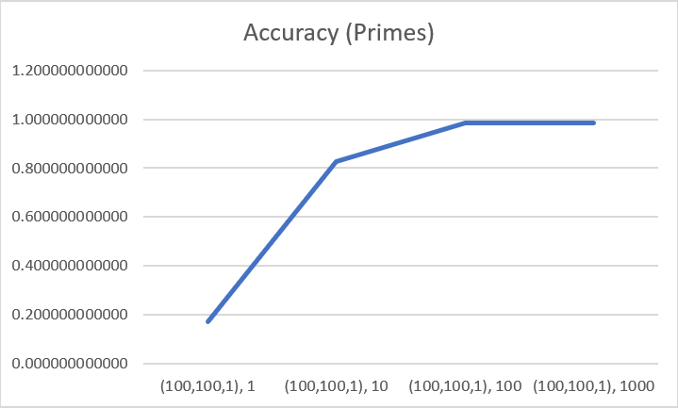
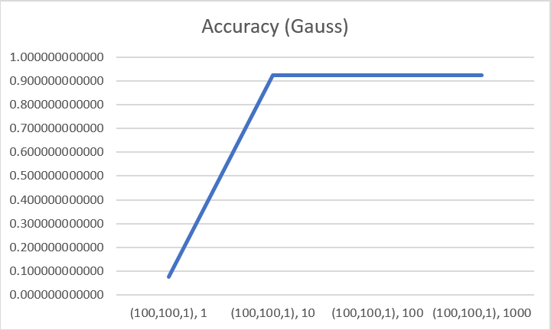
Data Results

Slide 23
Next Steps
Investigate different MLP and NN layer and node structures, using NEAT algorithm or Ant Colony Optimization.
Perform a Decision Tree on the attributes, and try to identify the attributes with the most/least impact on accuracy.
Collect data on run times and analyze the cost (run time) to benefit (accuracy), and see if accuracy can be maintained with less costly tests.

Slide 24
Future Attributes to Analyze
More bases for Fermat’s Little Theorem Set of Coprimes Members of Curves and Intersections of Sack’s Spiral Diagonals of Ulam’s Spiral Attributes of Lenstra’s Elliptic Curve Factorization

Slide 25
Goals of Future Work
Find a novel set of attributes to create a new prime/pseudoprime/composite test.
Find if a subset of primes can be reliably identified. Find a correlation between different spiral, or spiral like, organizations of natural numbers and the probability of being prime. i.e. prime density If so, attempt to use Genetic Programming to see if progress can be made on the Twin Prime Conjecture.

Slide 26
Sources
Wikipedia:
https://en.wikipedia.org/wiki/Primality_test
Wolfram/Mathematica:
http://mathworld.wolfram.com/Baillie-PSWPrimalityTest.html
http://mathworld.wolfram.com/LucasNumber.html
http://mathworld.wolfram.com/FermatsLittleTheorem.html
Sci Kit Learn:
http://scikit-learn.org/stable/

